Slide 1

Bank Marketing Campaign
Fredricka David

Slide 2
TABLE OF CONTENTS
Introduction
EDA & Recommendations
Model Recommendations
Evaluation
GitHub Repo

Slide 3
Introduction
Background: ABC Bank wants to sell it’s term deposit product to customers and before launching the product to customers they want to develop a model which help them in understanding whether a particular customer will buy their product or not (based on customer’s past interaction with bank or other Financial Institution).
Objective: It aims to develop a model with Duration and without duration feature and report the performance of the model.

Slide 4
Introduction
Business Understanding: ABC Bank wants to use a prediction model to shortlist customer who has better chances of buying the product so that their marketing channel (tele marketing, SMS/email marketing) can focus only to those customers whose chances of buying the product is more. It will save the bank resources and time (resource billing) It aims to develop a model with Duration and without duration feature and report the performance of the model.

Slide 5
Project Lifecycle
Week 7. 1. Problem Description 2.Business Understanding 3. Data Intake Report 19/Dec/2022
Week 8. 1. Problem Description 2.Data Understanding 3.Data Types 4.Data Problems 5.Approaches to data problems 26/Dec/2022
Week 9. 1. Data Cleaning and Transformation 02/Jan/2023
Week 10. 1.Problem Description 2.EDA Performed on the data 09/Jan/202
3.Final Recommendation

Slide 6
Project Lifecycle
Week 11. 1.Problem description 2.EDA presentation for business users 3. 16/Jan/2023
Week 12. 1.Model Selection 23/Jan/2023
Week 13. 1.Final Project Report 2.Link of your code and report 3.PowerPoint Presentation 30/Jan/2023

Slide 7
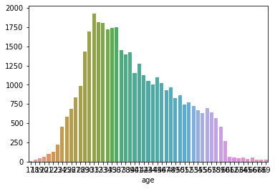
ANALYZING THE DATA - EDA
The graph shows the relation between the total number of applications the bank received and the age of the applicant. It can be seen that most applicants age varies from 25-60 years old.

Slide 8
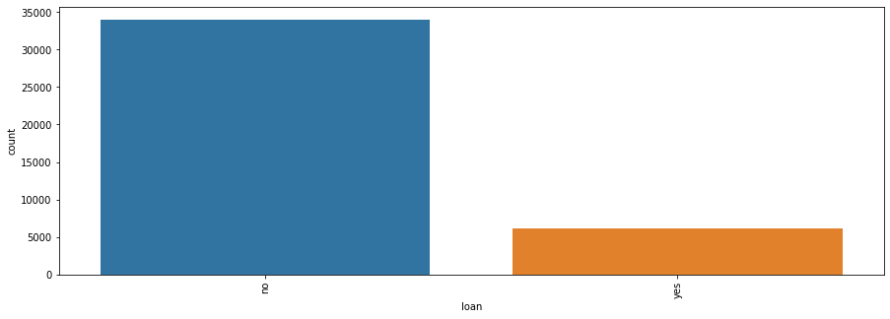
ANALYZING THE DATA - EDA
It can be seen that most of the accepted applications didn’t have a previous loan. Meaning that it can be taken into consideration in decision making.

Slide 9
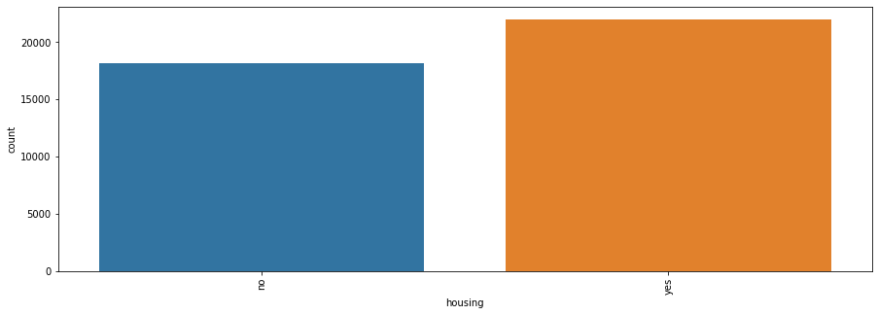
ANALYZING THE DATA - EDA
It can be seen that most of the accepted applications have house. The relation is not that high but it must be considered in decision making.

Slide 10
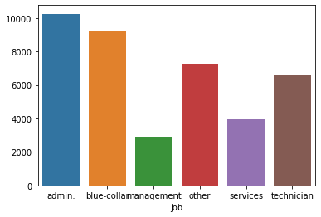
ANALYZING THE DATA - EDA
It shows some jobs have higher probability of getting accepted. It must be taken into consideration.

Slide 11
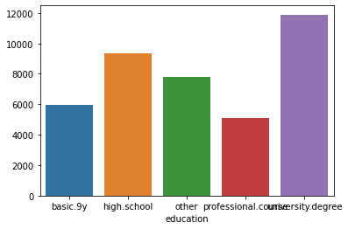
ANALYZING THE DATA - EDA
It can be seen education influences the probability of getting accepted. It must be taken into consideration.

Slide 12
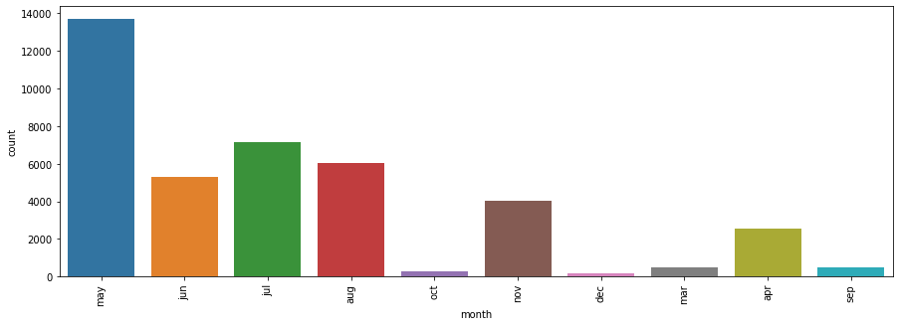
ANALYZING THE DATA - EDA
It shows that the month of application does not influences the probability of getting accepted. It must be taken into consideration.

Slide 13
FINAL RECOMMENDATIONS
There is a direct relation between the loan and the acceptance of the application.
Some jobs have higher priority for acceptance.
Some features do not have effect on the output as day and month.
In the heatmap we can see that the columns 'euribor3m', 'nr.employed' and 'emp.var.rate' are highly correlated.
The contact by phone seems to be more effective, what makes sense because it's easier to convince someone of something when you talk personally to them

Slide 14
MODEL RECOMMENDATION
Logistic Regression:
Logistic regression is easier to implement, interpret, and very efficient to train.
It makes no assumptions about distributions of classes in feature space.
It is very fast at classifying unknown records.
Logistic regression is less inclined to over-fitting but it can overfit in high dimensional datasets.One may consider Regularization (L1 and L2) techniques to avoid over-fittingin these scenarios.

Slide 15
MODEL EVALUATION
F1 Score: The F-score is a way of combining the precision and recall of the model.
Accuracy: 0.8959370643298148
Confusion Matrix: array([[8997, 0], [1045, 0]])
F1 Score: 0.0
Recall Value: 0.0
Prediction: 3.0

Slide 16
GITHUB REPO LINK
Fredricka23/Bank-Marketing-Campagain---Week-7: Specialization Project (github.com)

Slide 17
THANK YOU

